Slide 1

Packages & plugins
Wenxuan Shi
College of Software, Nankai University
Email: shiwx@nankai.edu.cn
Wechat: 13920561100

Slide 2
Introduction
What is the difference between a package and a plugin?
A plugin is a type of package—the full designation is plugin package, which is generally shortened to plugin.
Packages
At a minimum, a Dart package is a directory containing a pubspec file. Additionally, a package can contain dependencies (listed in the pubspec), Dart libraries, apps, resources, tests, images, and examples.
Plugins
A plugin package is a special kind of package that makes platform functionality available to the app. Plugin packages can be written for Android (using Kotlin or Java), iOS (using Swift or Objective-C), web, macOS, Windows, Linux, or any combination thereof.

Slide 3
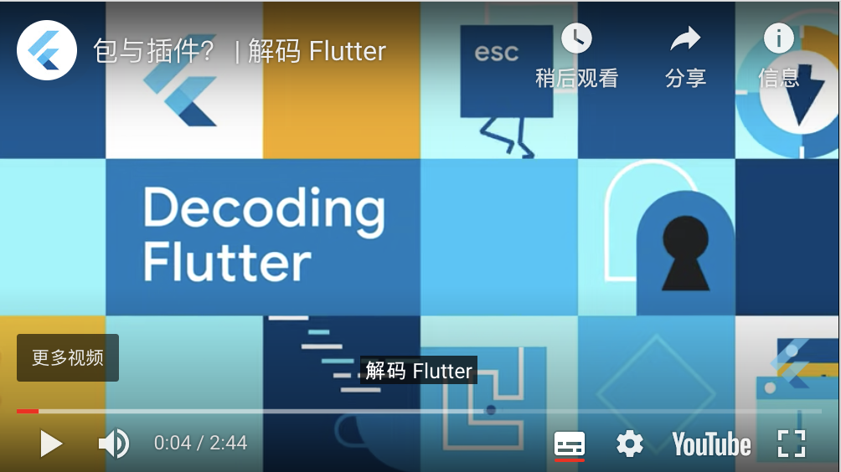
Topics
Using packages
Developing packages & plugins
https://youtu.be/Y9WifT8aN6o

Slide 4
Using packages
Notes:
StatelessWidget is used for immutable elements that only rely on the object configuration information
StatefulWidget is used for elements that can dynamically change based on state-changes in the system
Everytime that state changes, setChange() is called by the object

Slide 5
Introduction
Flutter supports using shared packages contributed by other developers to the Flutter and Dart ecosystems.
This allows quickly building an app without having to develop everything from scratch.
Existing packages enable many use cases—for example, making network requests (http), custom navigation/route handling (fluro), integration with device APIs (url_launcher and battery), and using third-party platform SDKs like Firebase (FlutterFire).

Slide 6
Searching for packages
Packages are published to pub.dev.
The Flutter landing page on pub.dev displays top packages that are compatible with.
The Flutter Favorites page on pub.dev lists the plugins and packages that have been identified as packages you should first consider using when writing your app.
You can also browse the packages on pub.dev by filtering on Android plugins, iOS plugins, web plugins, or any combination thereof.

Slide 7
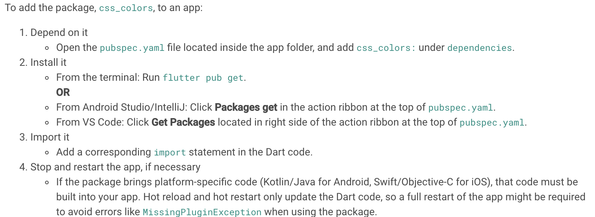
Adding a package dependency to an app

Slide 8
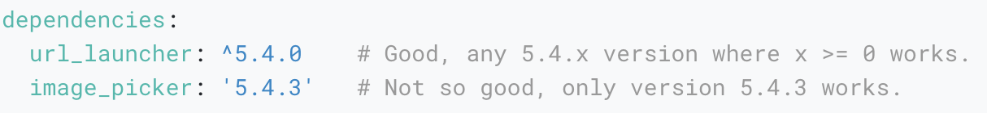
Conflict resolution
Suppose you want to use some_package and another_package in an app, and both of these depend on url_launcher, but in different versions. That causes a potential conflict.
The best way to avoid this is for package authors to use version ranges rather than specific versions when specifying dependencies.

Slide 9
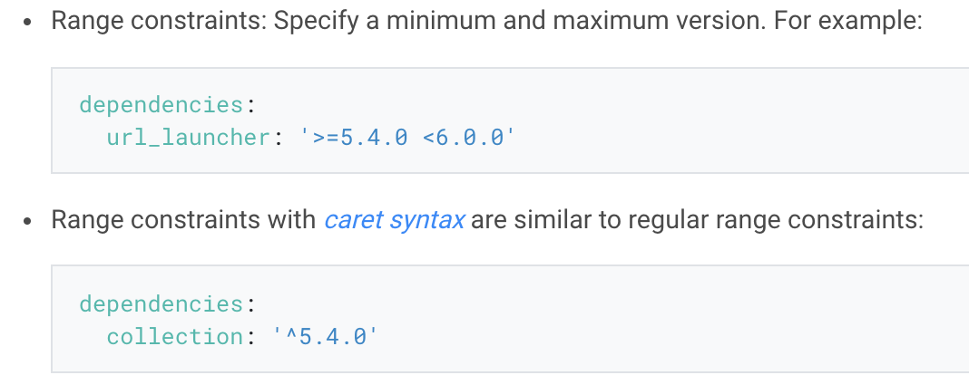
Managing package dependencies and versions
All packages have a version number, specified in the package’s pubspec.yaml file.

Slide 10
Updating package dependencies
When running flutter pub get (Packages get in IntelliJ or Android Studio) for the first time after adding a package, Flutter saves the concrete package version found in the pubspec.lock lockfile.
To upgrade to a new version of the package, for example to use new features in that package, run flutter pub upgrade (Upgrade dependencies in IntelliJ or Android Studio.

Slide 11
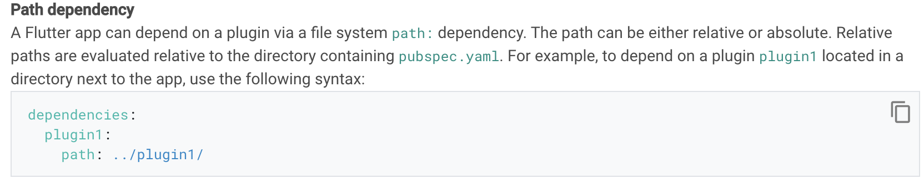
Dependencies on unpublished packages
Packages can be used even when not published on pub.dev.
For private plugins, or for packages not ready for publishing, additional dependency options are available:

Slide 12
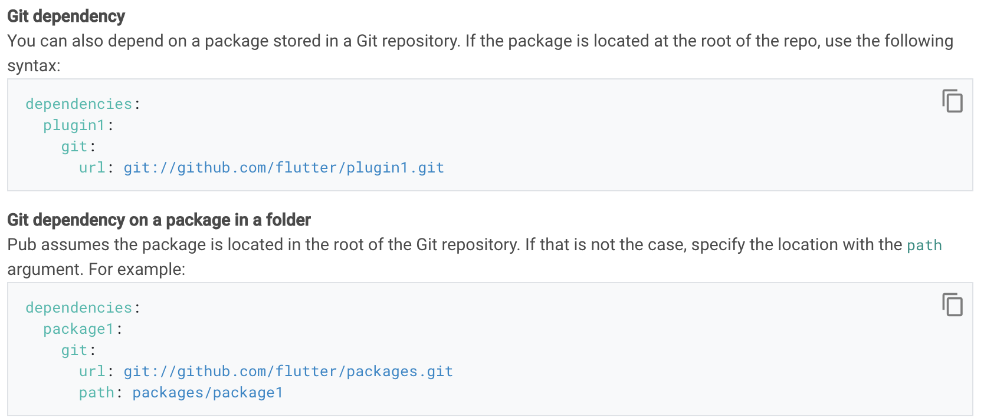

Slide 13
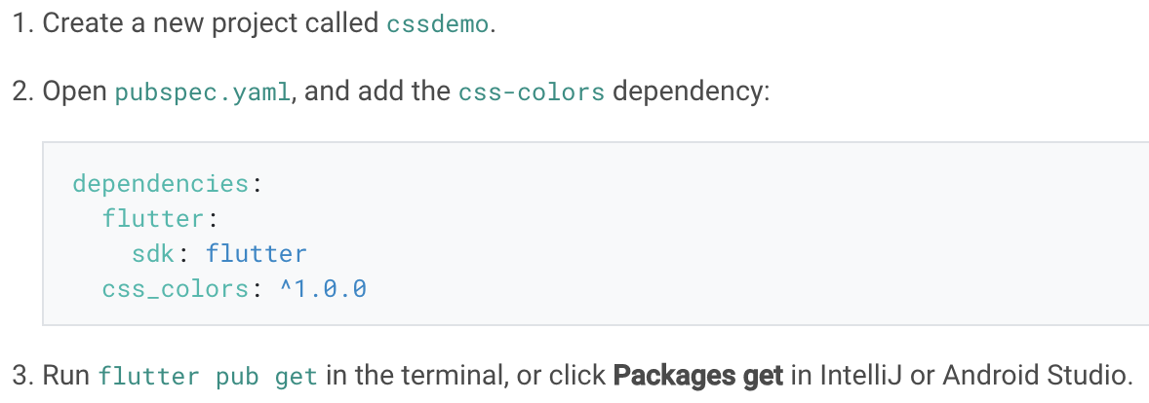
Example: Using the css_colors package
The css_colors package defines color constants for CSS colors, so use the constants wherever the Flutter framework expects the Color type.

Slide 14
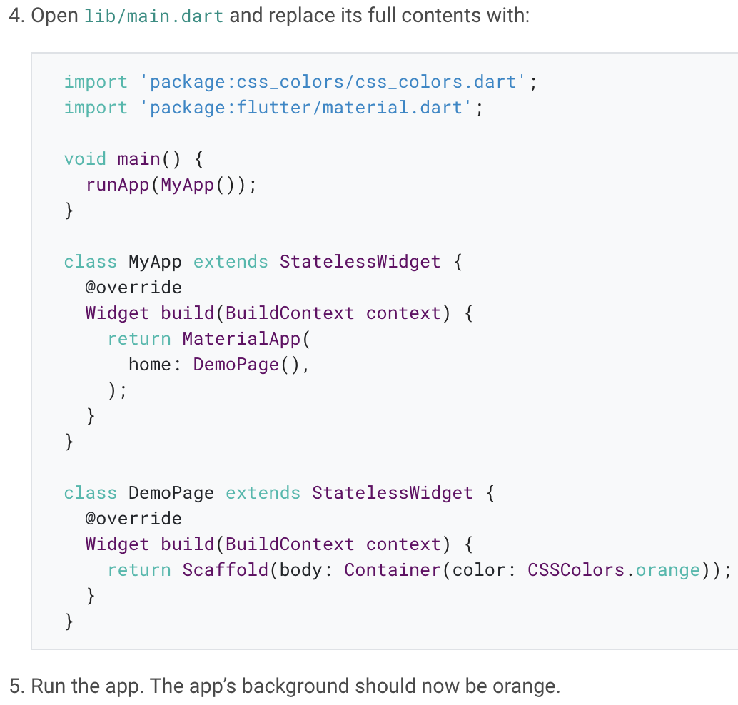
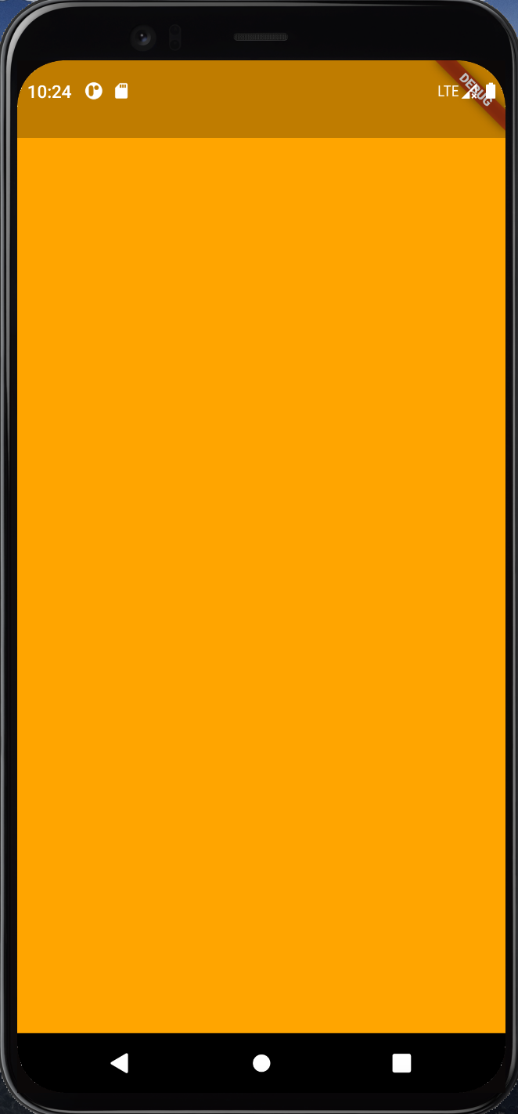

Slide 15
Example: Using the url_launcher package to launch the browser
The url_launcher plugin package enables opening the default browser on the mobile platform to display a given URL, and is supported on Android, iOS, web, and macos.
This package is a special Dart package called a plugin package (or plugin), which includes platform-specific code.

Slide 16
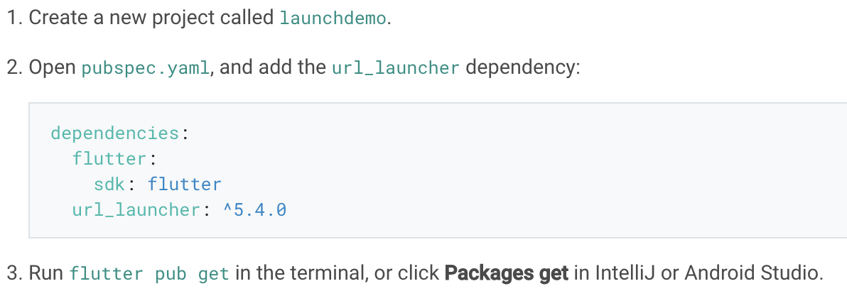

Slide 17
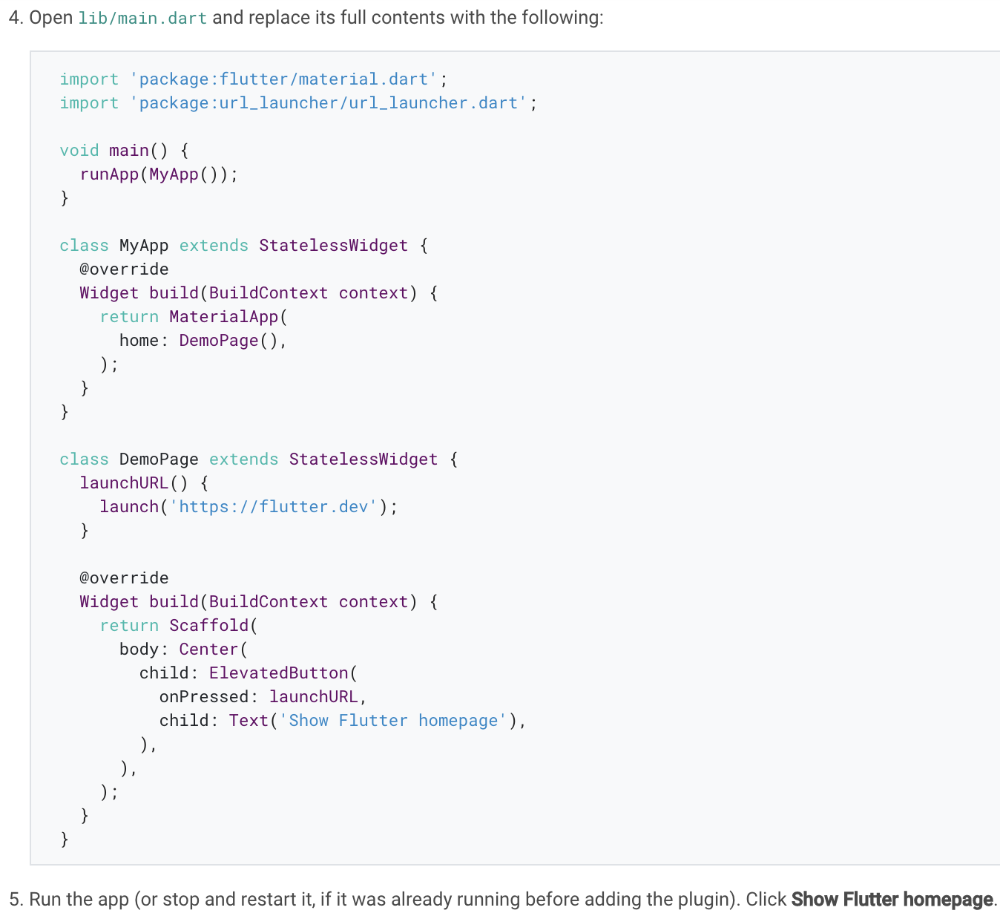
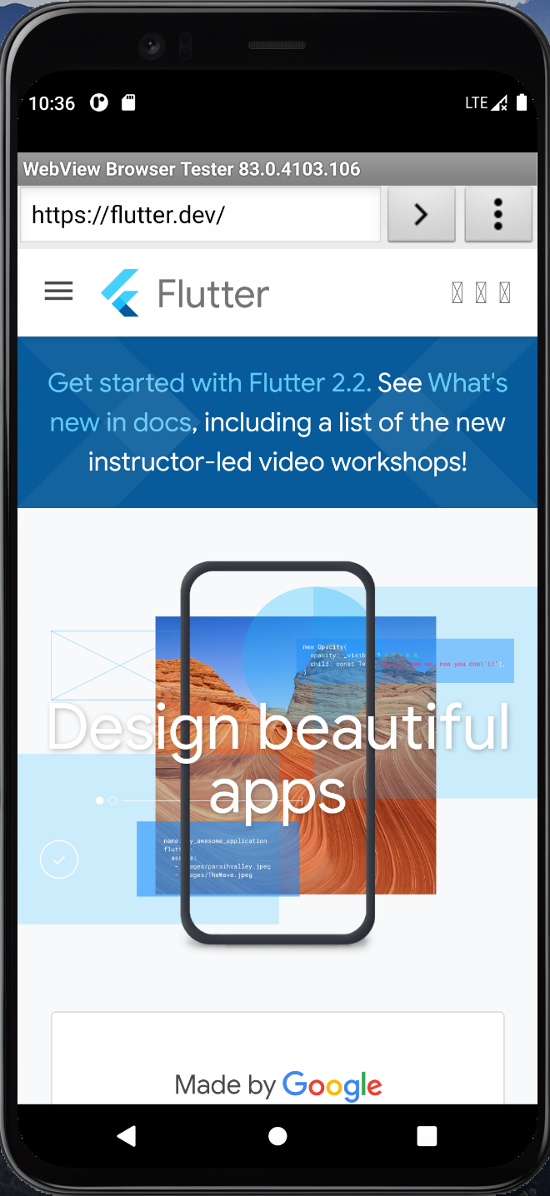

Slide 18
Developing packages & plugins
Notes:
StatelessWidget is used for immutable elements that only rely on the object configuration information
StatefulWidget is used for elements that can dynamically change based on state-changes in the system
Everytime that state changes, setChange() is called by the object

Slide 19
Package introduction
Packages enable the creation of modular code that can be shared easily.
A minimal package consists of the following:
pubspec.yaml: A metadata file that declares the package name, version, author, and so on.
Lib: The lib directory contains the public code in the package, minimally a single <package-name>.dart file.

Slide 20
Package types
Packages can contain more than one kind of content:
Dart packages: General packages written in Dart, for example the path package.
Plugin packages: A specialized Dart package that contains an API written in Dart code combined with one or more platform-specific implementations.
FFI Plugin packages: A specialized Dart package that contains an API written in Dart code combined with one or more platform-specific implementations that use Dart FFI.

Slide 21
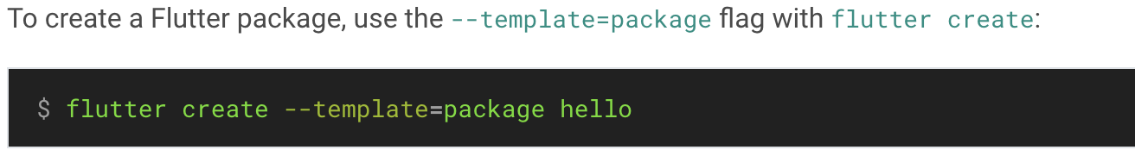
Developing Dart packages
Step 1: Create the package

Slide 22
Step 2: Implement the package
For pure Dart packages, simply add the functionality inside the main lib/<package name>.dart file, or in several files in the lib directory.
To test the package, add unit tests in a test directory.

Slide 23
Developing plugin packages
If you want to develop a package that calls into platform-specific APIs, you need to develop a plugin package.
The API is connected to the platform-specific implementation(s) using a platform channel.

Slide 24
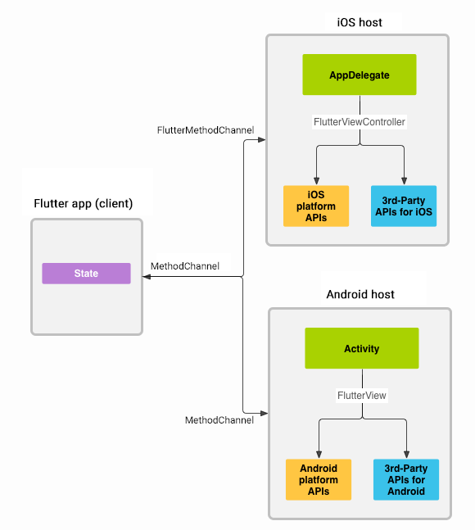
Architectural overview: platform channels
See: https://flutter.dev/docs/development/platform-integration/platform-channels

Slide 25
Federated plugins
Federated plugins are a way of splitting support for different platforms into separate packages.
So, a federated plugin can use one package for iOS, another for Android, another for web, and yet another for a car (as an example of an IoT device).

Slide 26
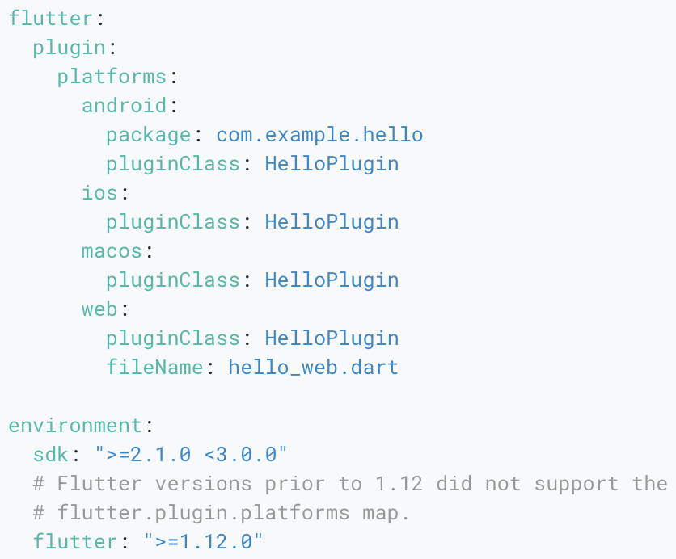
Specifying a plugin’s supported platforms
Plugins can specify the platforms they support by adding keys to the platforms map in the pubspec.yaml file.

Slide 27
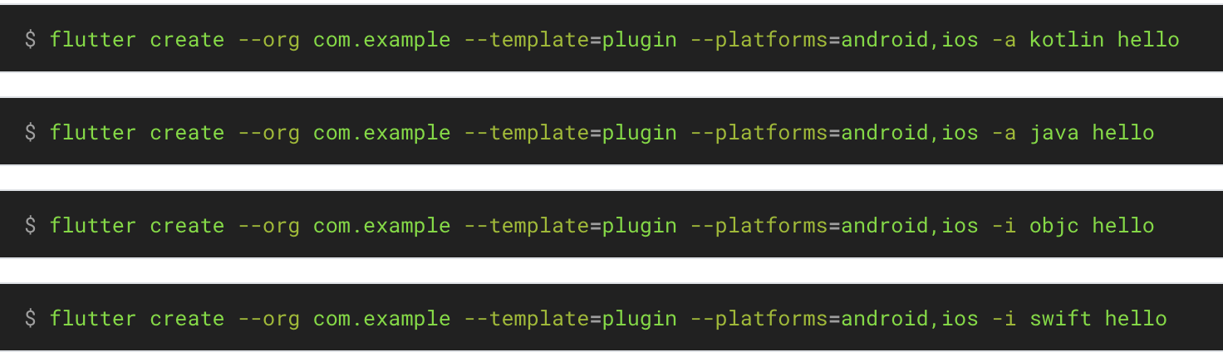
Step 1: Create the package
To create a plugin package, use the --template=plugin flag with flutter create.

Slide 28
Step 2: Implement the package
Step 2a: Define the package API (.dart)
The API of the plugin package is defined in Dart code. Open the main hello/ folder in your favorite Flutter editor. Locate the file lib/hello.dart.
Step 2b: Add Android platform code (.kt/.java)
We recommend you edit the Android code using Android Studio.
Step 2c: Add iOS platform code (.swift/.h+.m)
We recommend you edit the iOS code using Xcode.
Step 2d: Connect the API and the platform code
Finally, you need to connect the API written in Dart code with the platform-specific implementations.

Slide 29
Adding documentation
It is recommended practice to add the following documentation to all packages:
A README.md file that introduces the package
A CHANGELOG.md file that documents changes in each version
A LICENSE file containing the terms under which the package is licensed
API documentation for all public APIs

Slide 30
Publishing your package
Once you have implemented a package, you can publish it on pub.dev, so that other developers can easily use it.
Prior to publishing, make sure to review the pubspec.yaml, README.md, and CHANGELOG.md files to make sure their content is complete and correct.
Next, run the publish command in dry-run mode to see if everything passes analysis:
flutter pub publish --dry-run
The next step is publishing to pub.dev, but be sure that you are ready because publishing is forever:
flutter pub publish

Slide 31

Developing FFI plugin packages
If you want to develop a package that calls into native APIs using Dart’s FFI, you need to develop a FFI plugin package.
Step 1: Create the package
To create a starter FFI plugin package, use the --template=plugin_ffi flag with flutter create:

Slide 32
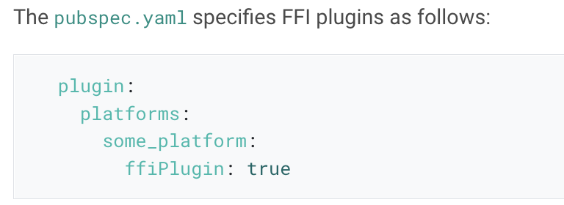
Step 2: Buidling and bundling native code

Slide 33
Step 3: Binding to native code
To use the native code, bindings in Dart are needed.
Step 4: Invoking native code
Very short-running native functions can be directly invoked from any isolate. For an example, see sum in lib/hello.dart.
Longer-running functions should be invoked on a helper isolate to avoid dropping frames in Flutter applications. For an example, see sumAsync in lib/hello.dart.

Slide 34
Adding documentation
It is recommended practice to add the following documentation to all packages:
A README.md file that introduces the package
A CHANGELOG.md file that documents changes in each version
A LICENSE file containing the terms under which the package is licensed
API documentation for all public APIs

Slide 35
Publishing your package
Once you have implemented a package, you can publish it on pub.dev, so that other developers can easily use it.
Prior to publishing, make sure to review the pubspec.yaml, README.md, and CHANGELOG.md files to make sure their content is complete and correct.
Next, run the publish command in dry-run mode to see if everything passes analysis:
flutter pub publish --dry-run
The next step is publishing to pub.dev, but be sure that you are ready because publishing is forever:
flutter pub publish

Slide 36
Thank you!
Wenxuan Shi
College of Software, Nankai University
Email: shiwx@nankai.edu.cn
Wechat: 13920561100

